Slide 1
WHO · Regional Office for Africa · ESPEN
Health Campaign Integration
Country calendar reviews & integration opportunities, 2026–2028
Prepared for the Campaign Integration Workshop · Kigali, 2026
Sierra Leone
Uganda
DR Congo
Angola
Rep. of Congo

Slide 2
Five-Country Integration Snapshot
WHO · AFRO · ESPEN
Campaign Integration Workshop · Kigali 2026
Planning calendars 2026–2028 · Sierra Leone · Uganda · DR Congo · Angola · Republic of the Congo
SIERRA LEONE
UGANDA
DR CONGO
ANGOLA
REP. OF CONGO
73
87
100
100
100
SCH + STH
top co-delivery match (/100)
SCH + STH
top co-delivery match (/100)
SCH + STH
top co-delivery match (/100)
LF + Oncho
top co-delivery match (/100)
STH + VAS
top co-delivery match (/100)
NTD preventive chemotherapy at the core. A spaced calendar leaves clear room to cluster school-based and CDD rounds.
Schistosomiasis & onchocerciasis now folded into the Mar–Oct windows; a ready ICHD platform — consolidate and de-conflict.
Co-delivery is already the model: four integrated streams, incl. a 5-disease NTD MDA delivered with polio.
Integrated measles–rubella + nOPV2 planned nationwide (Jul 2026), on a strong NTD co-delivery base.
Integrated 2028 bundle: yellow fever + ITN + vitamin A + child deworming co-scheduled across the year.
EMERGING
DENSE
ADVANCED
PLANNED
PLANNED
From planning to practice — the integration ladder
Every country is already planning some co-delivery; the opportunity is to climb higher.
COORDINATION
shared calendar
>
COLLABORATION
shared microplan & transport
>
CO-DELIVERY
same teams, same window
>
CO-ADMINISTRATION
given together to one person

Slide 3
Four Co-Delivery Archetypes
WHO · AFRO · ESPEN
Campaign Integration Workshop · Kigali 2026
Recurring integration patterns across the five country calendars, with the actions they call for
1
Community-directed NTD MDA
CO-ADMINISTRATION
2
School-based deworming & screening
CO-DELIVERY
Onchocerciasis + LF (± SCH, STH, Trachoma)
One ivermectin-based round through the CDD network
Schistosomiasis + STH (± HPV, Vitamin A)
Praziquantel + albendazole on the school platform
Where: All five countries · LF + Oncho = 100
Where: SL · Uganda · Angola · Congo · DRC · SCH + STH up to 100
3
Child health days (nutrition × EPI)
CO-DELIVERY
4
Integrated immunization SIAs
CO-ADMINISTRATION
Vitamin A + deworming + measles/YF (± ITN, MUAC)
Twice-yearly integrated child health days
Measles–Rubella + Polio (± Yellow Fever, OCV, TCV)
Shared cold chain, posts and microplanning
Where: DRC (JLV) · Congo · Uganda (ICHD) · Angola · STH + VAS = 100
Where: DRC · Angola (MR+nOPV2) · Congo · SL (MR+TCV) · Nationwide SIAs
ACT ON IT
1
Anchor integration on immunization SIAs and child health days as delivery platforms.
2
Co-administer CDD NTDs and school-based PC where diseases are co-endemic.
3
Confirm true co-location with admin-level microplanning; de-conflict peak months.
4
Invest in digital campaign management (e.g. DIGIT HCM) for microplanning & monitoring.

Slide 4
Sierra Leone
WHO · AFRO · ESPEN
Campaign Integration Workshop · Kigali 2026
NTD preventive chemotherapy at the core · Emerging integration
AT A GLANCE
Integration opportunities (by time and place)
73
2026 · Jul
Onchocerciasis + STH
Co-delivery
Co-administer ivermectin + albendazole via the CDD network (+ LF where co-endemic)
SCH + STH top match (/100)
2027–28
Schistosomiasis + STH
Co-delivery
PLANNING PERIOD
2026–2028
Align to a single school-based round (praziquantel + albendazole)
CAMPAIGNS SCORED
6 campaigns
2027 · Mar
ITN/LLIN + Measles-Rubella
Collaboration
INTEGRATION MATURITY
Shared social mobilisation, transport and microplanning
Emerging
Data note: Demo admin-1 names corrected (e.g. North West).
2027
Measles-Rubella + TCV
Collaboration
Shared cold chain & teams; consider a combined multi-antigen SIA

Slide 5
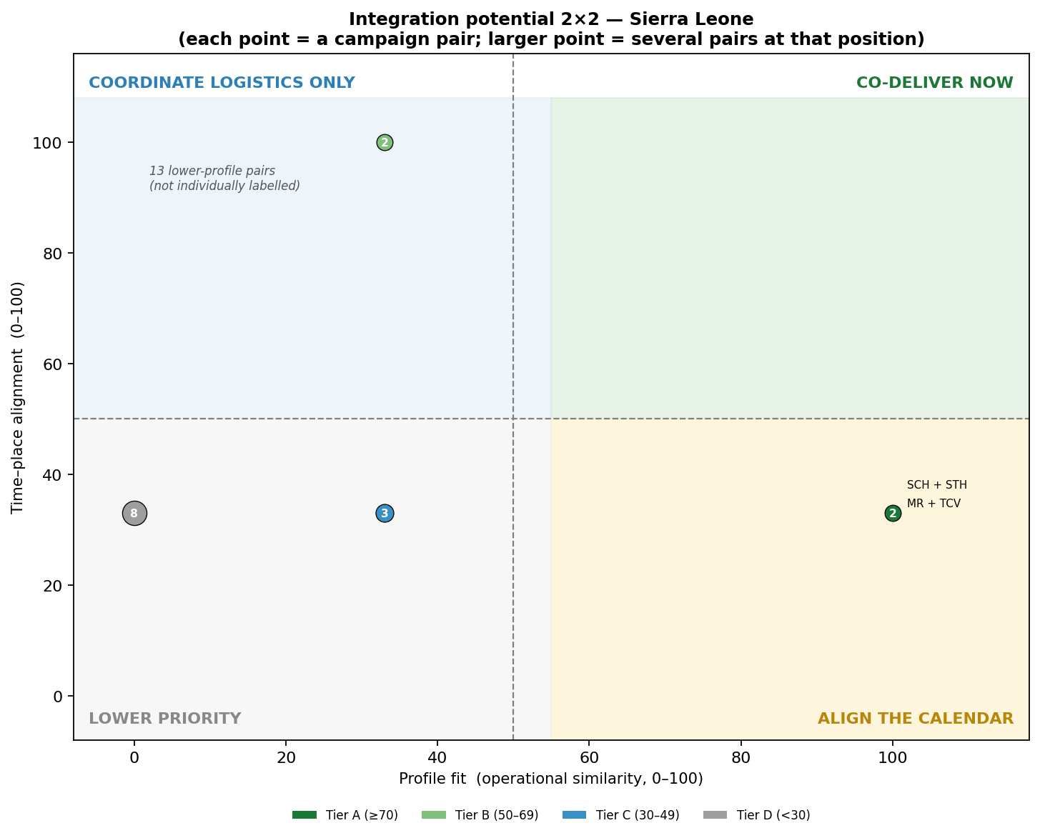
Sierra Leone — Profile-based integration scan
WHO · AFRO · ESPEN
Campaign Integration Workshop · Kigali 2026
Operational similarity × time–place alignment of every campaign pair
Top co-delivery matches
SCH + STH
73 · A
MR + TCV
73 · A
STH + Oncho
60 · B
Recommendations
Co-deliver onchocerciasis (± LF) and STH via CDD; combine SCH + STH in school rounds.
Share microplanning and cold chain for the MR and TCV immunization SIAs.
Confirm endemicity and WHO PC-NTD co-treatment eligibility before finalising.
2×2 triage — each point is a campaign pair (top-right = co-deliver now).
Note: Demo admin-1 names corrected (e.g. North West).

Slide 6
Uganda
WHO · AFRO · ESPEN
Campaign Integration Workshop · Kigali 2026
Dense 2026 calendar · ready Integrated Child Health Days platform
AT A GLANCE
Integration opportunities (by time and place)
87
2026 · Mar–Oct
HPV + STH + SCH + Vitamin A
Co-delivery
Integrated school health days: vaccination + deworming + PZQ + vitamin A
SCH + STH top match (/100)
2026 · Mar–Oct
Onchocerciasis + Trachoma
Co-delivery
PLANNING PERIOD
2026
Co-administer via the CDD network; schedule LF to join the same round
CAMPAIGNS SCORED
11 scheduled (LF undated)
2026 · Apr–Oct
SMC + Schistosomiasis
Collaboration
INTEGRATION MATURITY
Shared community mobilisation and microplanning in the same windows
Dense — consolidate
Data note: Updated submission; LF listed without scheduled months. National-level coverage — confirm with district microplanning.
2026 · Oct
Measles-Rubella + child-health round
Co-delivery
Fold the October MR campaign into the integrated child-health day

Slide 7
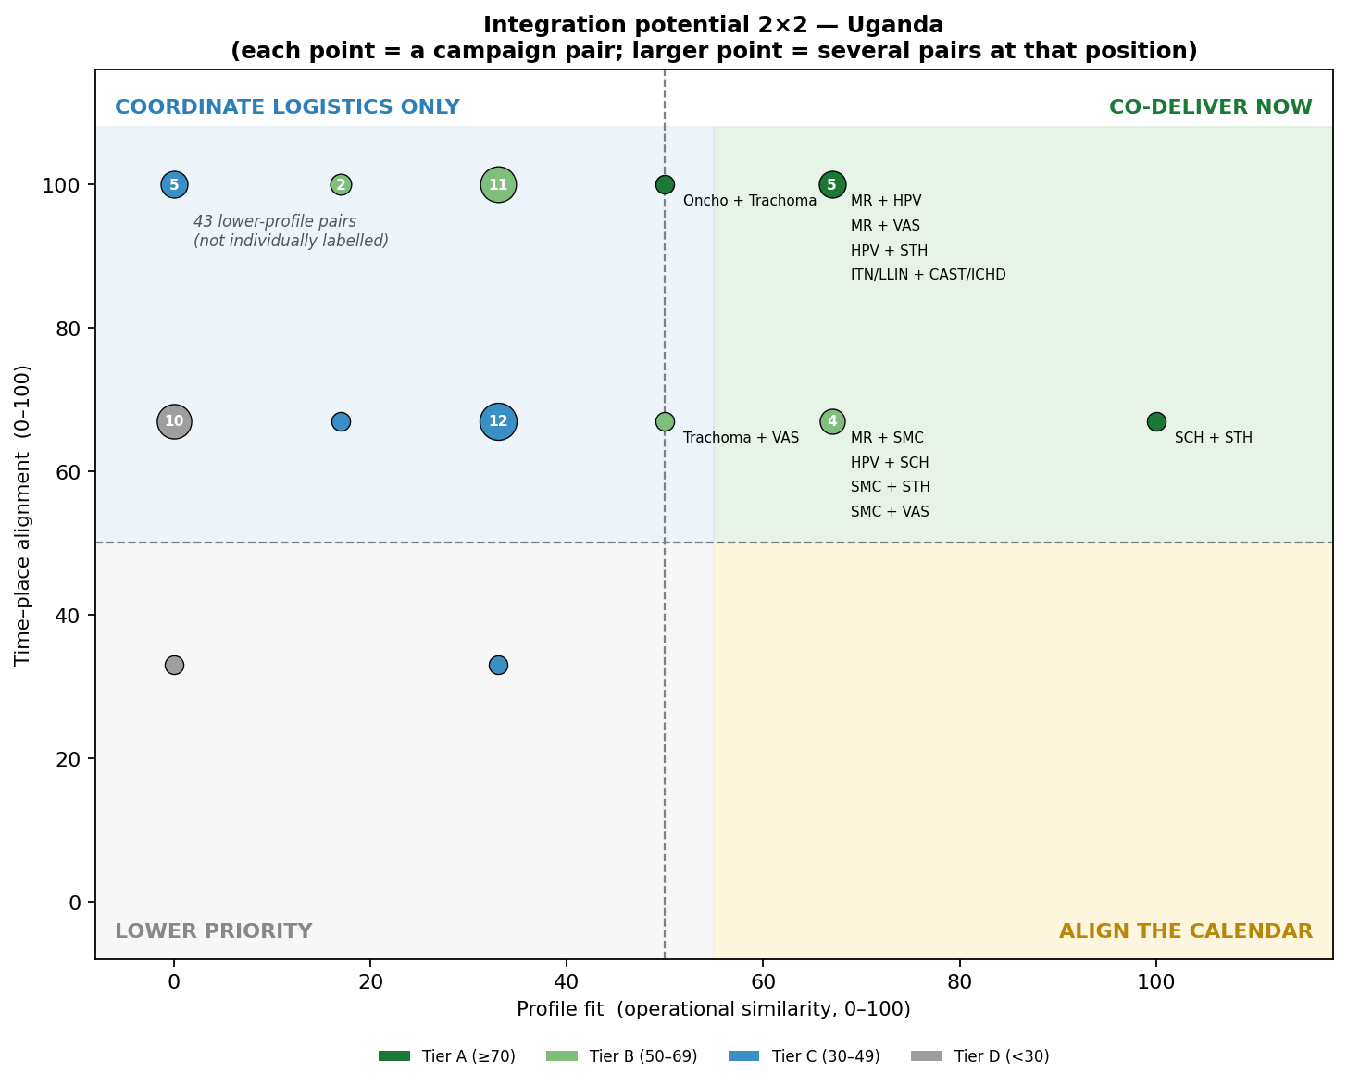
Uganda — Profile-based integration scan
WHO · AFRO · ESPEN
Campaign Integration Workshop · Kigali 2026
Operational similarity × time–place alignment of every campaign pair
Top co-delivery matches
SCH + STH
87 · A
HPV + STH
80 · A
MR + VAS
80 · A
Recommendations
Build integrated school & child-health days (HPV + deworming + PZQ + vitamin A) in the Mar/Apr/Sep/Oct windows.
Co-administer onchocerciasis + trachoma via CDD; schedule LF (currently undated) into the same round.
De-conflict the dense four-month period with district microplanning; capture admin-1 granularity.
2×2 triage — each point is a campaign pair (top-right = co-deliver now).
Note: Updated submission; LF listed without scheduled months. National-level coverage — confirm with district microplanning.

Slide 8
Democratic Republic of the Congo
WHO · AFRO · ESPEN
Campaign Integration Workshop · Kigali 2026
Four integrated streams already operating · regional reference
AT A GLANCE
Integration opportunities (by time and place)
100
2026 · Jul
Measles-Rubella + OPV/nVPO
Co-delivery
Integrated RR–Polio SIA across the Kasaï provinces and Kivus (PA 3.1/3.2)
SCH + STH top match (/100)
2026 · Jun
Vitamin A + STH (albendazole)
Co-administration
PLANNING PERIOD
2026–2028
Integrated vitamin A + deworming round in 9 provinces
CAMPAIGNS SCORED
13 campaigns
2026 · Dec
ITN + VAS + STH + MUAC
Co-delivery
INTEGRATION MATURITY
Integrated VitA–Albendazole–MUAC–MIILD bundle (PA 3.4)
Advanced
Data note: Re-mapped from the national plan; province lists need country verification.
2026 · Nov
Oncho + LF + SCH + STH + Trachoma + OPV
Co-administration
Integrated NTD MDA (IVM+PZQ+ALB+AZI+TEO) with polio (Maniema, PA 3.3)

Slide 9
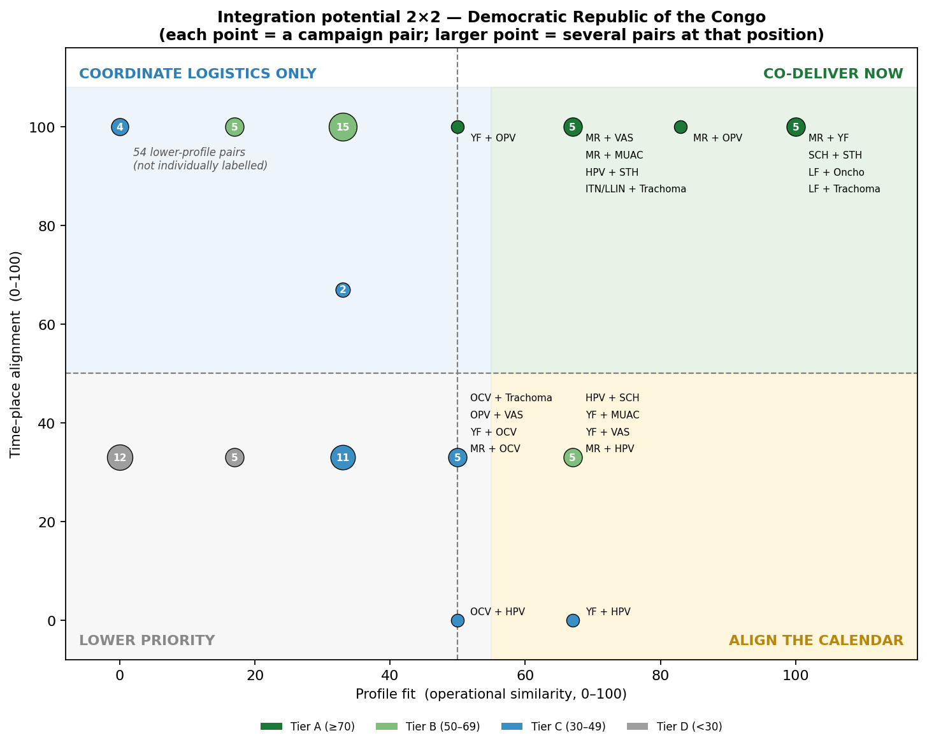
DR Congo — Profile-based integration scan
WHO · AFRO · ESPEN
Campaign Integration Workshop · Kigali 2026
Operational similarity × time–place alignment of every campaign pair
Top co-delivery matches
SCH + STH
100 · A
Oncho + Trachoma
100 · A
MR + YF
100 · A
Recommendations
Sustain the four integrated streams (RR–Polio, JLV nutrition bundle, NTD MDA, EPI–nutrition).
Extend co-delivery where ages align; advance DIGIT HCM for microplanning & monitoring.
Verify the re-mapped workbook and the NTD-package disease split against the national plan.
2×2 triage — each point is a campaign pair (top-right = co-deliver now).
Note: Re-mapped from the national plan; province lists need country verification.

Slide 10
Angola
WHO · AFRO · ESPEN
Campaign Integration Workshop · Kigali 2026
Nationwide MR + nOPV2 (Jul 2026) · strong NTD co-delivery base
AT A GLANCE
Integration opportunities (by time and place)
100
2026 · Jul
Measles-Rubella + OPV/nVPO
Co-delivery
Integrated MR + nOPV2 SIA already planned across the provinces
LF + Oncho top match (/100)
2026 · Jul
Onchocerciasis + LF
Co-administration
PLANNING PERIOD
2026–2028
Co-administer ivermectin (± IDA) via shared CDD network (co-endemic provinces)
CAMPAIGNS SCORED
4 scored (of 6 reported)
2026 · Jun/Aug
Schistosomiasis + STH
Co-delivery
INTEGRATION MATURITY
Align SCH (Jun) and STH (Aug) into one school-based round
Planned
Data note: Built on template example rows; MR & OPV not profiled (excluded from scoring).
2026 · Jul
NTD round overlaps MR + OPV
Coordination
Where age-eligible, align the CDD NTD round with the July immunization campaign

Slide 11
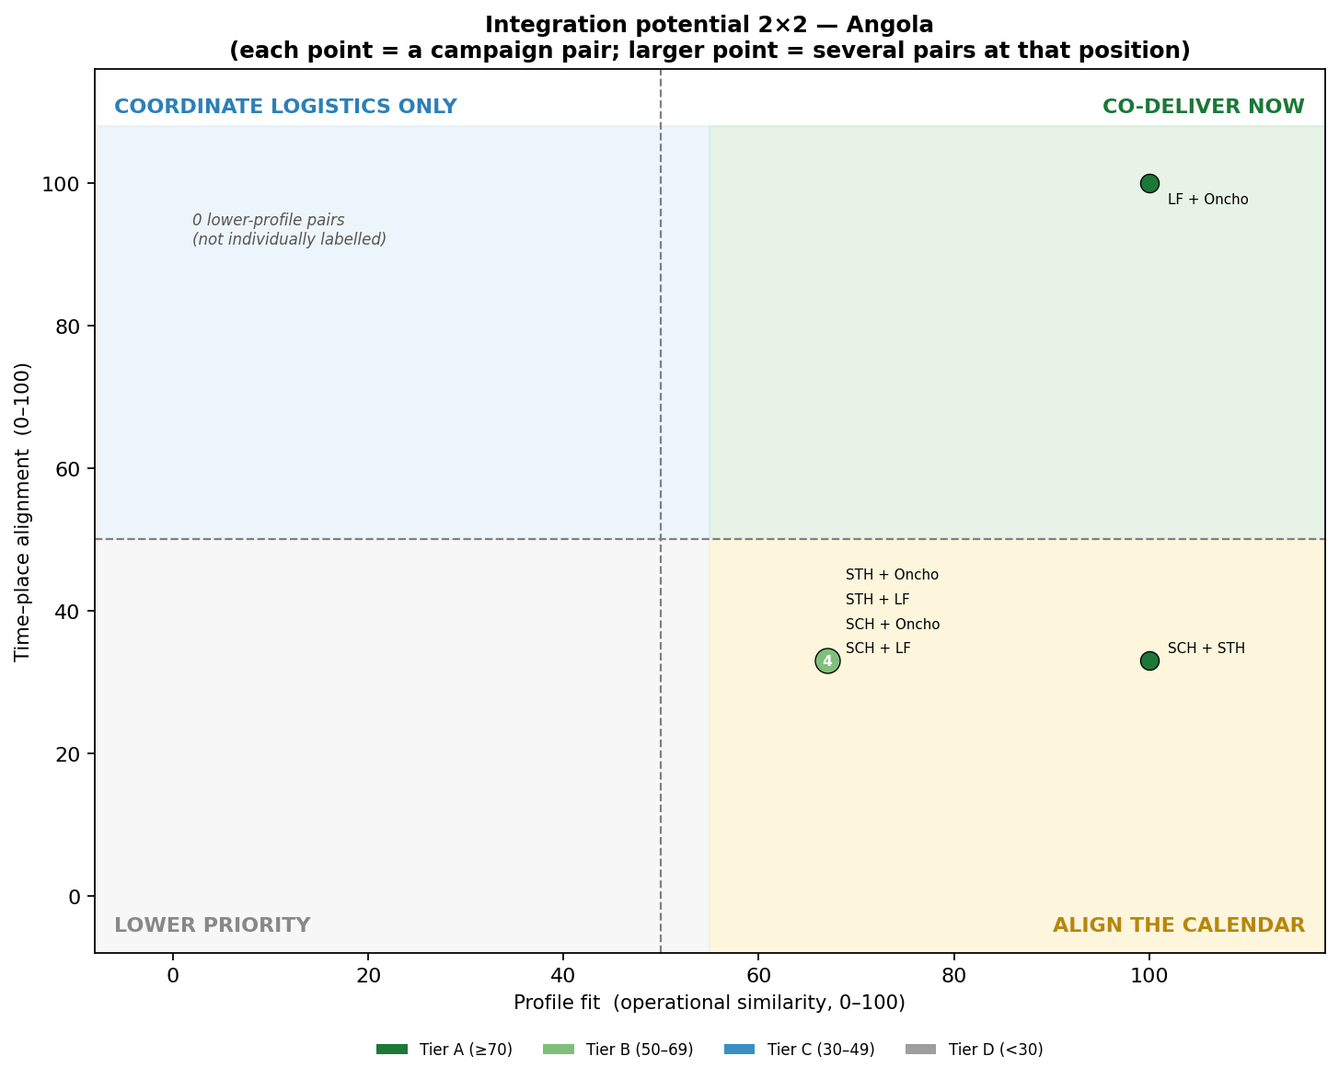
Angola — Profile-based integration scan
WHO · AFRO · ESPEN
Campaign Integration Workshop · Kigali 2026
Operational similarity × time–place alignment of every campaign pair
Top co-delivery matches
LF + Oncho
100 · A
SCH + STH
73 · A
SCH + Oncho
53 · B
Recommendations
Run the July MR + nOPV2 round as the anchor for further integration.
Co-administer oncho + LF in co-endemic provinces; align SCH + STH school round.
Complete the workbook (add WHO-aligned profiles for MR, OPV and the 'Outro' antigen).
2×2 triage — each point is a campaign pair (top-right = co-deliver now).
Note: Built on template example rows; MR & OPV not profiled (excluded from scoring).

Slide 12
Republic of the Congo
WHO · AFRO · ESPEN
Campaign Integration Workshop · Kigali 2026
Integrated 2028 bundle · genuine national plan
AT A GLANCE
Integration opportunities (by time and place)
100
2028
Vitamin A + STH + Yellow Fever (+ ITN)
Co-delivery
Sustain the planned integrated nutrition + immunization bundle
STH + VAS top match (/100)
2028 · Jun
HPV + Vitamin A + STH
Collaboration
PLANNING PERIOD
2026–2028
Align school-based HPV with school deworming and vitamin A
CAMPAIGNS SCORED
8 campaigns
2027
Measles-Rubella SIA
Co-delivery
INTEGRATION MATURITY
Use the broad MR window as an anchor for vitamin A / deworming
Planned
Data note: Corrupted Synthèse rebuilt; geography reported at generic admin-1 level.
2026
Ebola (Aug) · Schistosomiasis (Nov)
Coordination
Stand-alone; coordinate planning only

Slide 13
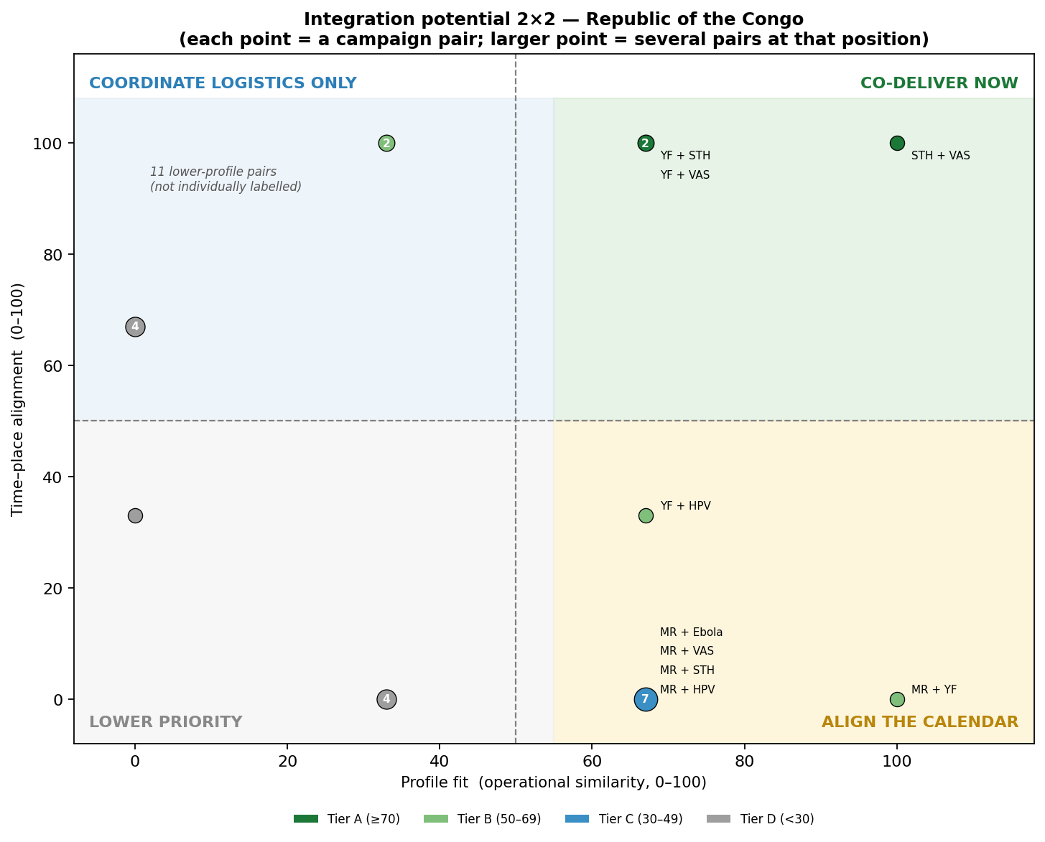
Rep. of the Congo — Profile-based integration scan
WHO · AFRO · ESPEN
Campaign Integration Workshop · Kigali 2026
Operational similarity × time–place alignment of every campaign pair
Top co-delivery matches
STH + VAS
100 · A
YF + VAS
80 · A
YF + STH
80 · A
Recommendations
Sustain the integrated 2028 bundle (yellow fever + ITN + vitamin A + deworming).
Align HPV with school deworming & vitamin A; anchor on the 2027 measles-rubella SIA.
Capture departments for true co-location; keep the Ebola campaign stand-alone.
2×2 triage — each point is a campaign pair (top-right = co-deliver now).
Note: Corrupted Synthèse rebuilt; geography reported at generic admin-1 level.

Slide 14
Five countries, one direction
Co-delivery is already happening — the task is to make it systematic.
1
Already underway Every country plans some co-delivery — DR Congo already co-administers a 5-disease NTD round with polio.
2
Four repeatable archetypes CDD NTD MDA · school-based deworming · child health days · integrated immunization SIAs.
3
Scale with microplanning + digital tools Confirm co-location at admin level, de-conflict peak months, and invest in digital campaign management (e.g. DIGIT HCM).
WHO · AFRO · ESPEN · Campaign Integration Workshop · Kigali 2026

